Slide 1
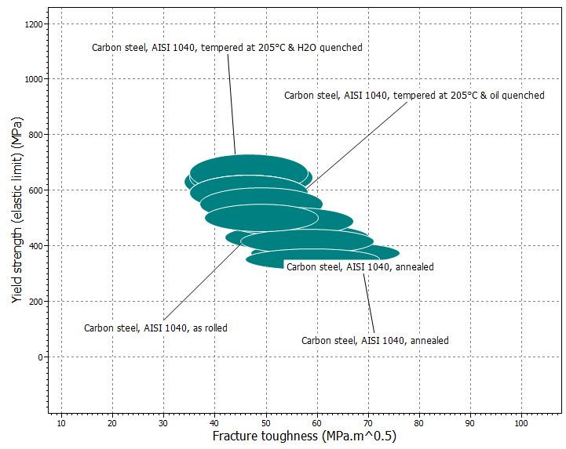
1040 Plain carbon steel: effect of heat treatment

Slide 2
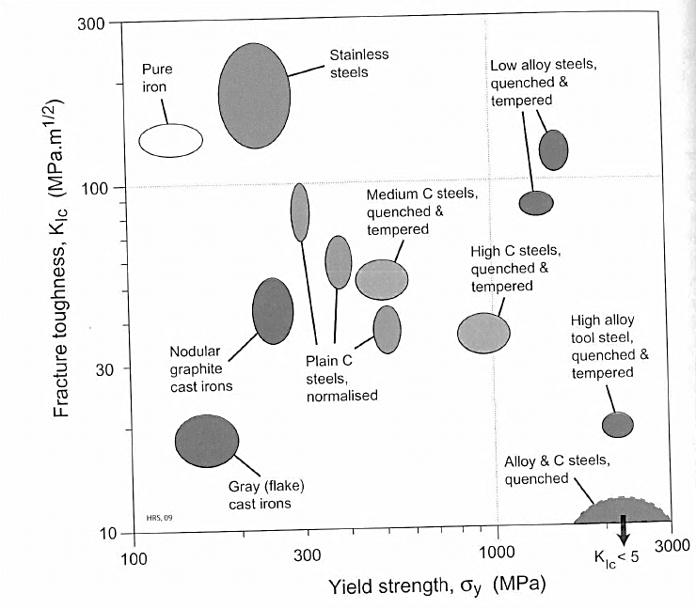
Various Fe-C alloy properties

Slide 3
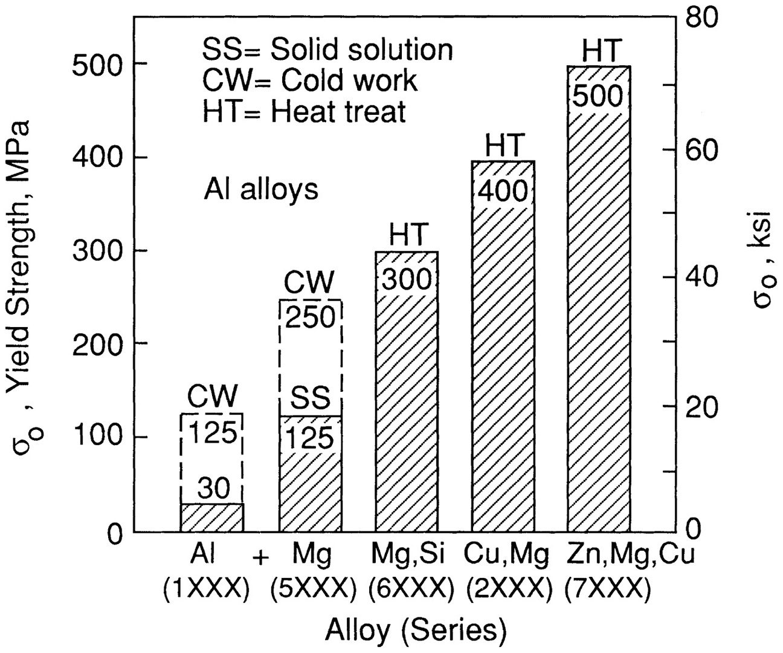
Aluminum Strengthening
Illustration by R. W. Landgraf

Slide 4
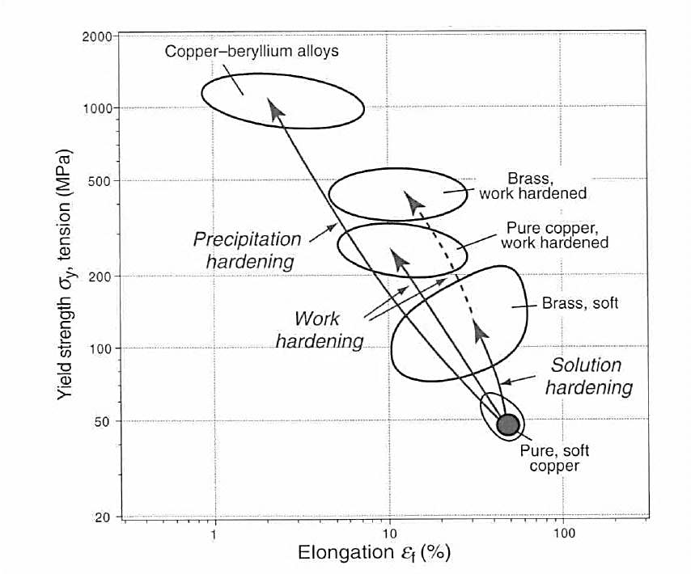
Strengthening of Copper

